Slide 1

LHC: A New Frontier
Eric Prebys
Fermilab
Director, US LHC Accelerator Research Program
Google welcome screen from September 10, 2008

Slide 2

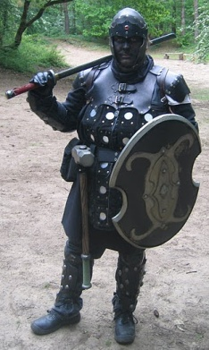
A Word about LARP
The US LHC Accelerator Research Program (LARP) coordinates US R&D related to the LHC accelerator and injector chain at Fermilab, Brookhaven, SLAC, and Berkeley (with a little at J-Lab and UT Austin)
LARP has contributed to the initial operation of the LHC, but much of the program is focused on future upgrades.
The program is currently funded at a level of about $12-13M/year, divided among:
Accelerator research
Magnet research
Programmatic activities, including support for personnel at CERN
NOT to be confused with this “LARP” (Live-Action Role Play), which has led to some interesting emails
“Dark Raven”

Slide 3
Outline
The road to the LHC and key features
Protons vs. electrons
Colliding beam vs. fixed target
Proton-proton vs. proton-antiproton
Fun facts about superconducting magnets
LHC commissioning
First start up
The “incident” of September 19th, 2008
The repairs
Current Status and near term plans
The future
Limits to luminosity
Long term plans

Slide 4
It’s all about energy and collision rate
To probe smaller scales, we must go to higher energy
To discover new particles, we need enough energy available to create them
The Higgs particle, the last piece of the Standard Model probably has a mass of about 150 GeV, just at the limit of the Fermilab Tevatron
Many theories beyond the Standard Model, such as SuperSymmetry, predict a “zoo” of particles in the range of a few hundred GeV to a few TeV
Of course, we also hope for surprises.
The rarer a process is, the more collisions (luminosity) we need to observe it.
~size of proton

Slide 5
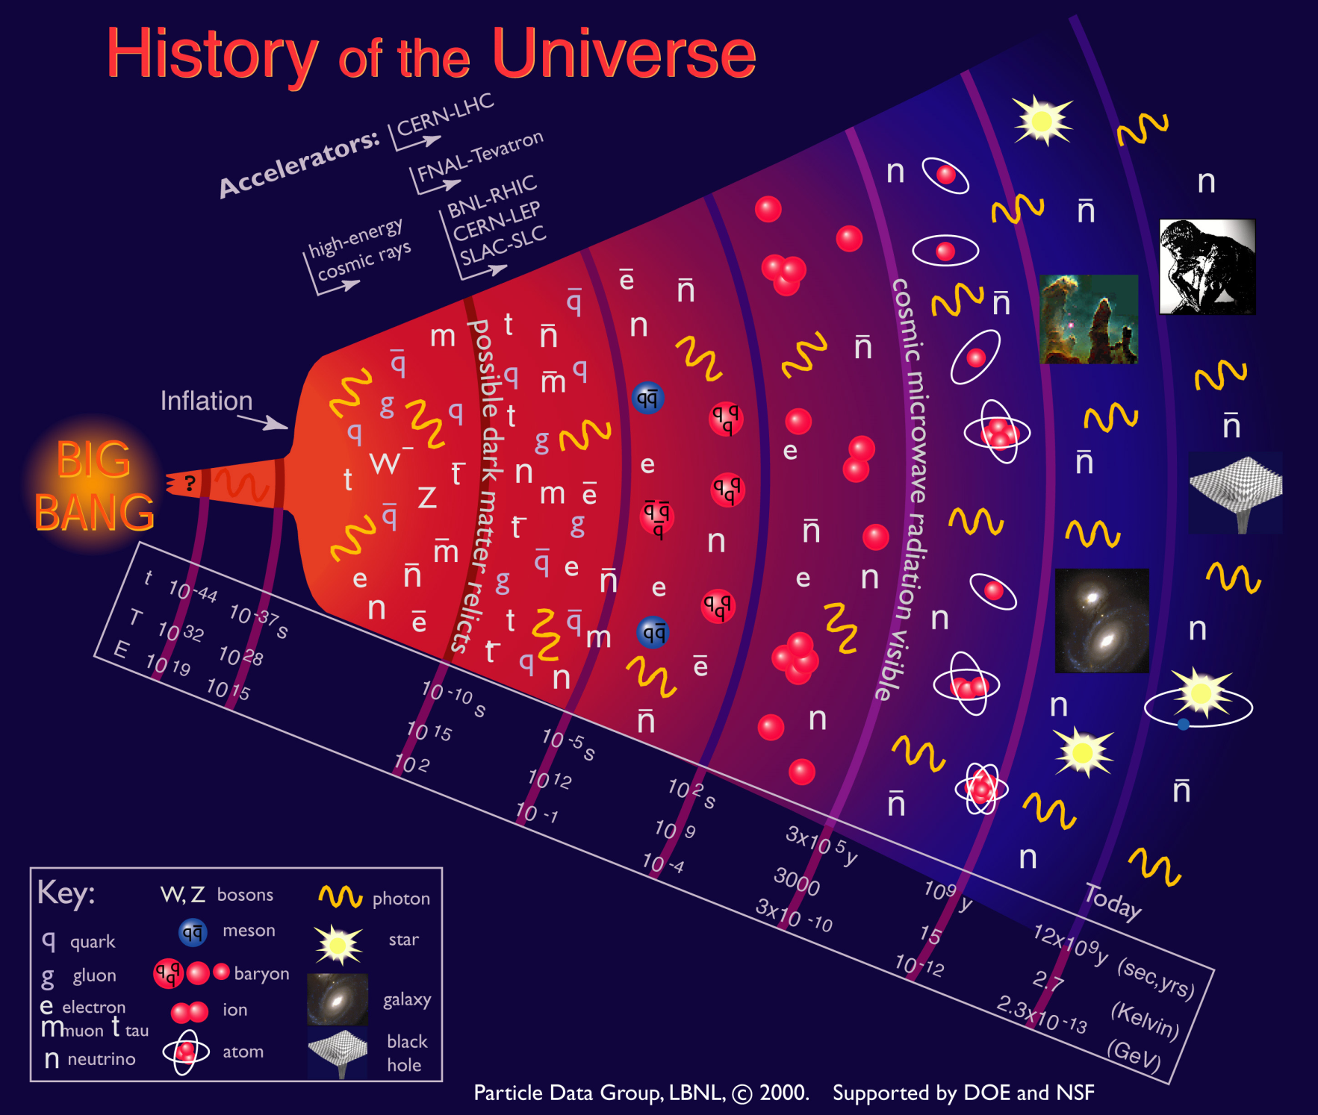
Accelerators allow us to probe down to a few picoseconds after the Big Bang

Slide 6
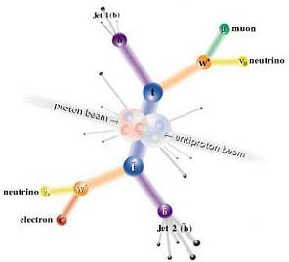
Electrons (leptons) vs. Protons (hadrons)
Electrons are point-like
Well-defined initial state
Full energy available to interaction
Can calculate from first principles
Can use energy/momentum conservation to find “invisible” particles.
Protons are made of quarks and gluons
Interaction take place between these consituents.
At high energies, virtual “sea” particles dominate
Only a small fraction of energy available, not well-defined.
Rest of particle fragments -> big mess!
So why don’t we stick to electrons??

Slide 7
Synchrotron Radiation: a Blessing and a Curse
As the trajectory of a charged particle is deflected, it emits “synchrotron radiation”
Radius of curvature
An electron will radiate about 10¹³ times more power than a proton of the same energy!!!!
Protons: Synchrotron radiation does not affect kinematics very much
Electrons: Beyond a few MeV, synchrotron radiation becomes very important, and by a few GeV, it dominates kinematics - Good Effects: - Naturally “cools” beam in all dimensions - Basis for light sources, FEL’s, etc. - Bad Effects: - Beam pipe heating - Exacerbates beam-beam effects - Energy loss ultimately limits circular accelerators

Slide 8
Practical Consequences of Synchrotron Radiation
Proton accelerators
Synchrotron radiation not an issue to first order
Energy limited by the maximum feasible size and magnetic field.
Electron accelerators
To keep power loss constant, radius must go up as the square of the energy (B∝1/E ⇒ weak magnets, BIG rings):
The LHC tunnel was built for LEP, and e⁺e⁻ collider which used the 27 km tunnel to contain 100 GeV beams (1/70th of the LHC energy!!)
Beyond LEP energy, circular synchrotrons have no advantage for e⁺e⁻
-> International Linear Collider (but that’s another talk)
What about muons?
Point-like, but heavier than electrons
Unstable
That’s another talk, too…
Since the beginning, the energy frontier has belonged to proton (and/or antiproton) machines

Slide 9
The Case for Colliding Beams
For a relativistic beam hitting a fixed target, the center of mass energy is:
On the other hand, for colliding beams (of equal energy):
To get the 14 TeV CM design energy of the LHC with a single beam on a fixed target would require that beam to have an energy of 100,000 TeV!
Would require a ring 10 times the diameter of the Earth!!

Slide 10
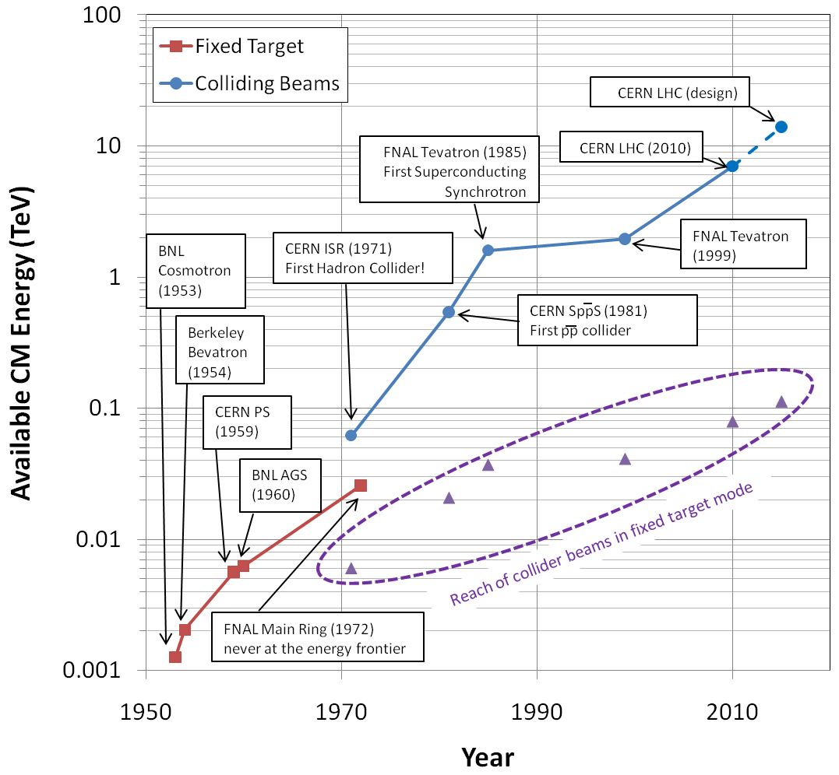
Evolution of the Energy Frontier
~a factor of 10 every 15 years

Slide 11
Proton-Proton vs. Proton-antiproton
Beyond a few hundred GeV, most interactions take place between gluons and/or virtual “sea” quarks.
No real difference between proton- antiproton and proton-proton
A particle going in one direction through a magnetic field will behave exactly the same as an antiparticle going in the other direction
Can put protons and antiprotons in the same ring
That’s how the SppS and the Tevatron work
The problem is that antiprotons are hard to make
Can only get about 1 antiproton for every 50,000 protons on target!
Takes a day to make enough antiprotons for a “store” in the Fermilab Tevatron
Ultimately, the luminosity is limited by the antiproton current.
Thus, the LHC was designed as a proton-proton collider.

Slide 12
Luminosity
Rate
The relationship of the beam to the rate of observed physics processes is given by the “Luminosity”
Cross-section (“physics”)
“Luminosity”
Standard unit for Luminosity is cm⁻²s⁻¹ Standard unit of cross section is “barn”=10⁻²⁴ cm² Integrated luminosity is usually in barn⁻¹,where
nb⁻¹ = 10⁹ b⁻¹, fb⁻¹=10¹⁵ b⁻¹, etc
For (thin) fixed target:
Target thickness
Example: MiniBooNe primary target:
Incident rate
Target number density

Slide 13
Colliding Beam Luminosity
Circulating beams typically “bunched”
(number of interactions)
Cross-sectional area of beam
Total Luminosity:
Circumference of machine
Number of bunches
Record e+e- Luminosity (KEK-B): 2.11x10³⁴ cm⁻²s⁻¹ Record Hadronic Luminosity (Tevatron): 4.03x10³² cm⁻²s⁻¹ LHC Design Luminosity: 1.00x10³⁴ cm⁻²s⁻¹

Slide 14
Superconducting Magnets
For a proton accelerator, we want the most powerful magnets we can get
Conventional electromagnets are limited by the resistivity of the conductor (usually copper)
The field of high duty factor conventional magnets is limited to about 1 Tesla
An LHC made out of such magnets would be 40 miles in diameter – approximately the size of Rhode Island.
The highest energy accelerators are only possible because of superconducting magnet technology.
The SppS (first proton antiproton collider) used conventional magnets, and therefore could not run in collider mode at its maximum energy.
Power lost
Square of the field

Slide 15
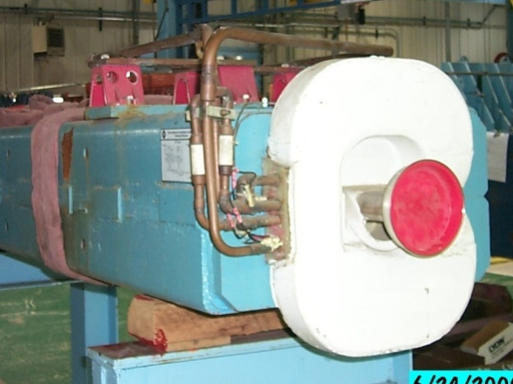
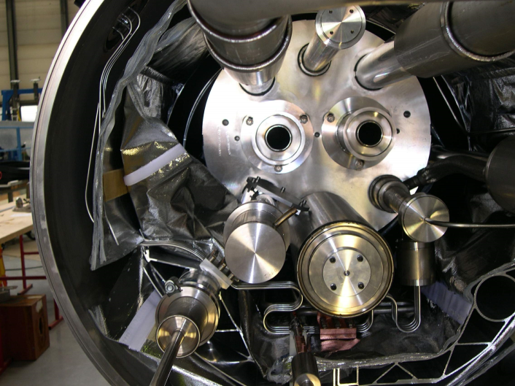
Issues with Superconducting Magnets
Conventional magnets operate at room temperature. The cooling required to dissipate heat is usually provided by fairly simple low conductivity water (LCW) heat exchange systems.
Superconducting magnets must be immersed in liquid (or superfluid) He, which requires complex infrastructure and cryostats
Any magnet represents stored energy
In a conventional magnet, this is dissipated during operation.
In a superconducting magnet, you have to worry about where it goes, particularly when something goes wrong.

Slide 16
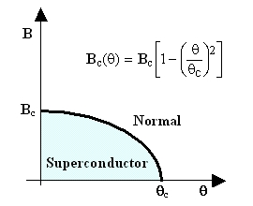
When is a superconductor not a superconductor?
Superconductor can change phase back to normal conductor by crossing the “critical surface”
When this happens, the conductor heats quickly, causing the surrounding conductor to go normal and dumping lots of heat into the liquid Helium
This is known as a “quench”.
Can push the B field (current) too high
Can increase the temp, through heat leaks, deposited energy or mechanical deformation
T_{c}

Slide 17

Quench Example: MRI Magnet*
*pulled off the web. We recover our Helium.

Slide 18
Quench protection
When a small section of superconductor quenches, the resulting energy deposition could damage the magnet.
The quench protection system (QPS) detects quenches via resistive voltage drop:
trigger heaters which drive the rest of the conductor out of the superconducting phase, thereby dissipating the energy deposition
(usually) shunt current away into a dump load
Magnet “training”
The electromechanical stress on the conductors can cause small motions, triggering quenches through friction.
This will typically “seat” the conductor better, so it can go to a higher field the next time.
Most magnets rely on this “training” to reach their design fields

Slide 19
Milestones on the Road to a Superconducting Collider
1911 – superconductivity discovered by Heike Kamerlingh Onnes
1957 – superconductivity explained by Bardeen, Cooper, and Schrieffer
1972 Nobel Prize (the second for Bardeen!)
1962 – First commercially available superconducting wire
NbTi, the “industry standard” since
1978 – Construction began on ISABELLE, first superconducting collider (200 GeV+200 GeV) at Brookhaven.
1983, project cancelled due to design problems, budget overruns, and competition from…
1978 – Work begins in earnest on the Fermilab Tevatron, a 1 TeV+1 TeV collider in the Fermilab Main Ring tunnel
Breaks energy record in 1983
First collisions in 1985
Most powerful collider in the world since then (980 GeV+980 GeV)
until now

Slide 20
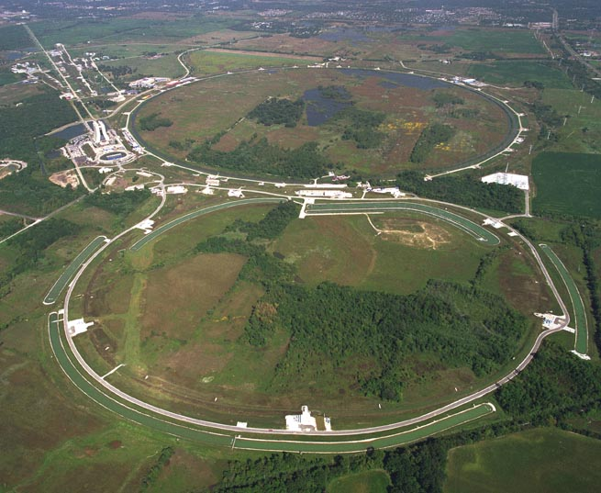
Fermilab: Utopia on the Prairie
History
1968 – Construction begins.
1972 – First 200 GeV beam in the Main Ring (400 GeV later that year)
1983 – First (512 GeV) beam in the Tevatron (“Energy Doubler”). Old Main Ring serves as “injector”.
1985 – First proton-antiproton collisions observed at CDF (1.6 TeV CoM). Most powerful accelerator in the world for the next quarter century
1995 – Top quark discovery. End of Run I.
1999 – Main Injector complete.
2001 – Run II begins.
2011 – 10 fb⁻¹/experiment

Slide 21
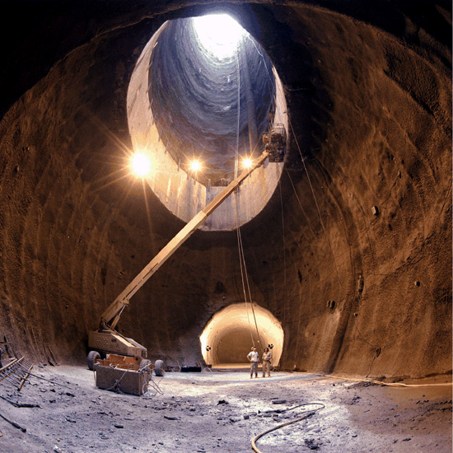
The (side) Road to Higher Energy
1980’s - US begins planning in earnest for a 20 TeV+20 TeV “Superconducting Super Collider” or (SSC).
87 km in circumference!
Considered superior to the “Large Hadron Collider” (LHC) then being proposed by CERN.
1987 – site chosen near Dallas, TX
1989 – construction begins
1993 – amidst cost overruns and the end of the Cold War, the SSC is canceled after 17 shafts and 22.5 km of tunnel had been dug.

Slide 22
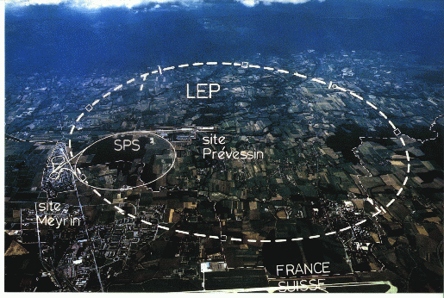
LHC: Location, Location, Location…
My House (1990-1992)
/LHC
Tunnel originally dug for LEP
Built in 1980’s as an electron positron collider
Max 100 GeV/beam, but 27 km in circumference!!

Slide 23
Partial LHC Timeline
1994:
The CERN Council formally approves the LHC
1995:
LHC Technical Design Report
2000:
LEP completes its final run
First dipole delivered
2005
Civil engineering complete (CMS cavern)
First dipole lowered into tunnel
2007
Last magnet delivered
First sector cold
All interconnections completed
2008
Accelerator complete
Last public access
Ring cold and under vacuum

Slide 24
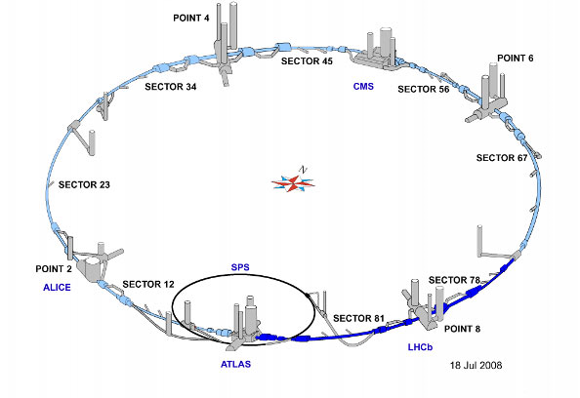
LHC Layout
8 crossing interaction points (IP’s)
Accelerator sectors labeled by which points they go between
ie, sector 3-4 goes from point 3 to point 4

Slide 25
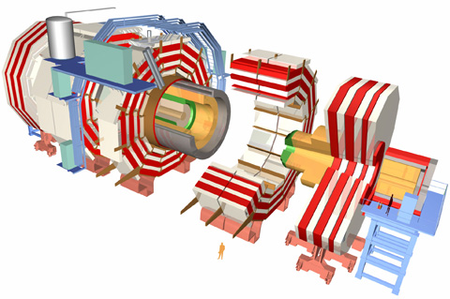
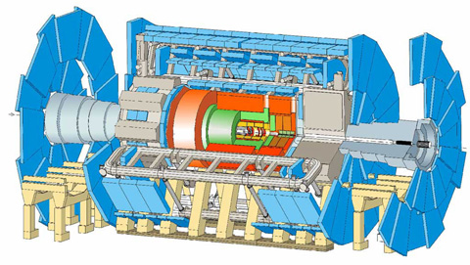
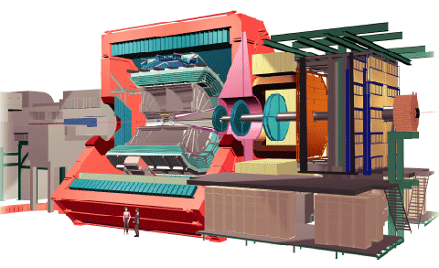
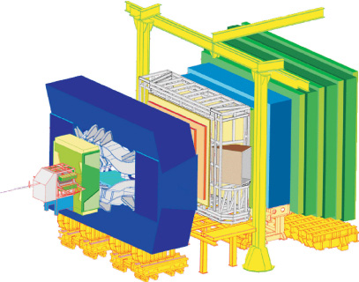
LHC Experiments
Damn big, general purpose experiments:
“Medium” special purpose experiments:
Compact Muon Solenoid (CMS)
A Toroidal LHC ApparatuS (ATLAS)
A Large Ion Collider Experiment (ALICE)
B physics at the LHC (LHCb)

Slide 26
Nominal LHC Parameters Compared to Tevatron
Parameter | Tevatron | “nominal” LHC
Circumference | 6.28 km (2*PI) | 27 km
Beam Energy | 980 GeV | 7 TeV
Number of bunches | 36 | 2808
Protons/bunch | 275x10⁹ | 115x10⁹
pBar/bunch | 80x10⁹ | -
Stored beam energy | 1.6 + .5 MJ | 366+366 MJ*
Peak luminosity | 3.3x10³² cm⁻²s⁻¹ | 1.0x10³⁴ cm⁻²s⁻¹
Main Dipoles | 780 | 1232
Bend Field | 4.2 T | 8.3 T
Main Quadrupoles | ~200 | ~600
Operating temperature | 4.2 K (liquid He) | 1.9K (superfluid He)
1.0x10³⁴ cm⁻²s⁻¹ ~ 50 fb⁻¹/yr
*2.1 MJ ≡ “stick of dynamite” ⇒ very scary numbers

Slide 27
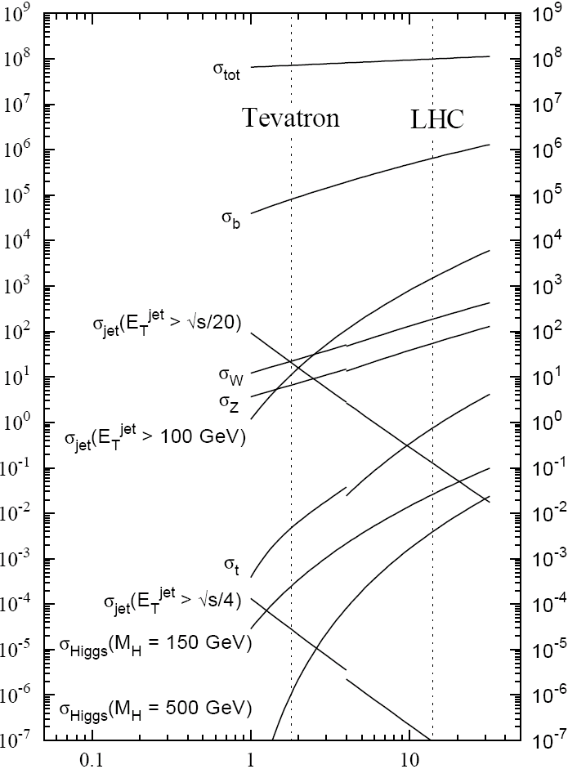
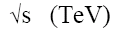
Experimental Reach of LHC vs. Tevatron
Increase in cross section of 3 to 5 orders magnitude for some important physics signatures
σ_{W} (M_{W}=80 GeV)
σ_{Z} (M_{Z}=91 GeV)

Slide 28
What is done during commissioning?
The LHC would have no hope of ever working if there had not been a thorough quality control program in effect during all phases of construction and installation.
However, it would be naïve to believe there are not still problems to solve, perhaps some of them significant, which will only be discovered when beam circulates.
During beam commissioning
Exercise all systems, looking for mistakes and problems.
Methodically proceed with beam injection
Look for mistakes
Make corrections for inevitable imperfections

Slide 29
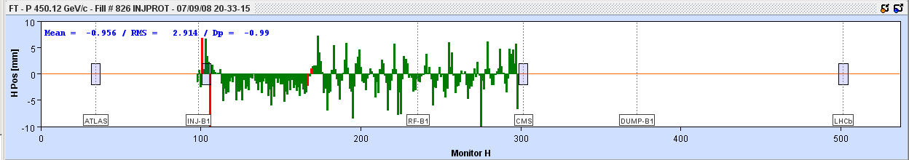
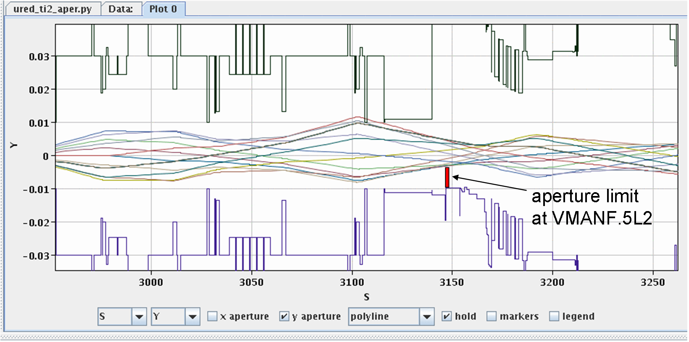
Example: Injection Test
Beam direction
Mis-steering
Aperture scan: move beam around until you hit something
Injection region aperture point 2

Slide 30
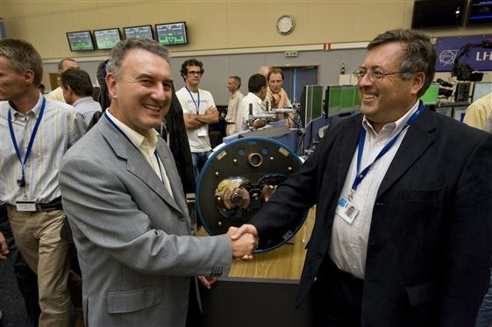
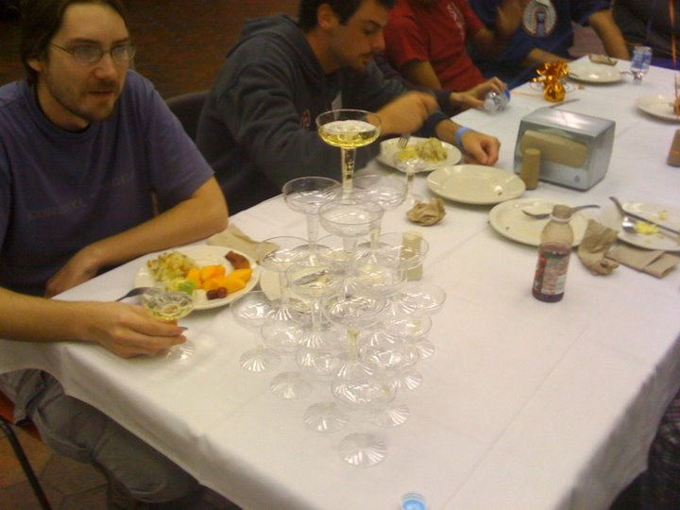
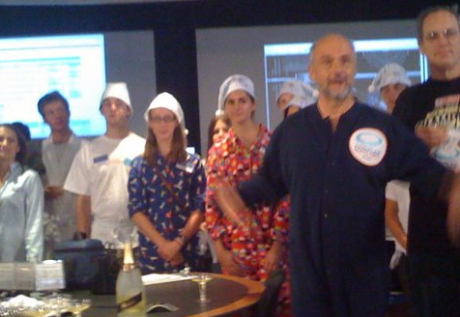
Sept 10, 2008: The (first) Big Day
9:35 – First beam injected
9:58 – beam past CMS to point 6 dump
10:15 – beam to point 1 (ATLAS)
10:26 – First turn!
…and there was much rejoicing
Things were going great for 9 days until something very bad happened.

Slide 31

Nature abhors a (news) vacuum…
Italian newspapers were very poetic (at least as translated by “Babel Fish”):
"the black cloud of the bitterness still has not been dissolved on the small forest in which they are dipped the candid buildings of the CERN"
“Lyn Evans, head of the plan, support that it was better to wait for before igniting the machine and making the verifications of the parts.“*
Or you could Google “What really happened at CERN”:
**
* “Big Bang, il test bloccato fino all primavera 2009”, Corriere dela Sera, Sept. 24, 2008
**http://www.rense.com/general83/IncidentatCERN.pdf

Slide 32
What (really) really happened?*
Sector 3-4 was being ramped to 9.3 kA, the equivalent of 5.5 TeV
All other sectors had already been ramped to this level
Sector 3-4 had previously only been ramped to 7 kA (4.1 TeV)
A quench developed in the splice between a dipole and the neighboring quadrupole
Not initially detected by quench protection circuit
Within the first second, an arc formed at the site of the quench
The heat of the arc caused Helium to boil.
The pressure rose beyond .13 MPa and ruptured into the insulation vacuum.
Vacuum also lost in the beam pipe
The pressure at the subsector vacuum barrier reached ~10 bar
design value: 1.5 bar
This force was transferred to the magnet stands, which broke.
*Official talk by Philippe LeBrun, Chamonix, Jan. 2009

Slide 33
Pressure Forces on Vacuum Barrier
Vacuum
Pressure
1 bar
1/3 load on cold mass (and support post)
~23 kN
1/3 load on barrier
~46 kN
Total load on 1 jack ~70 kN
V. Parma

Slide 34
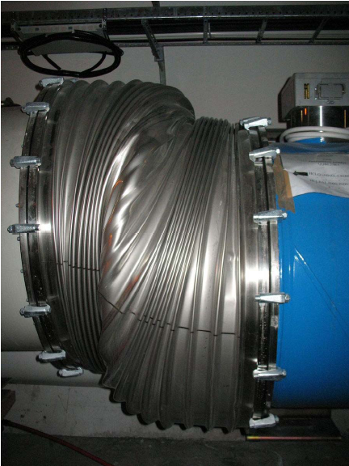
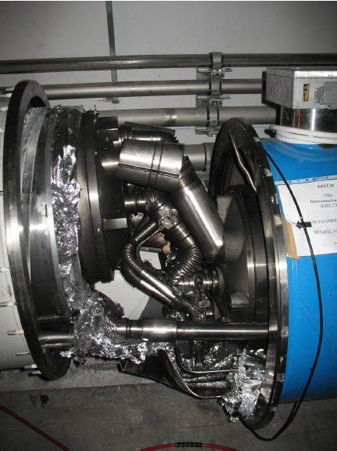
Collateral Damage: Magnet Displacements
QQBI.27R3

Slide 35
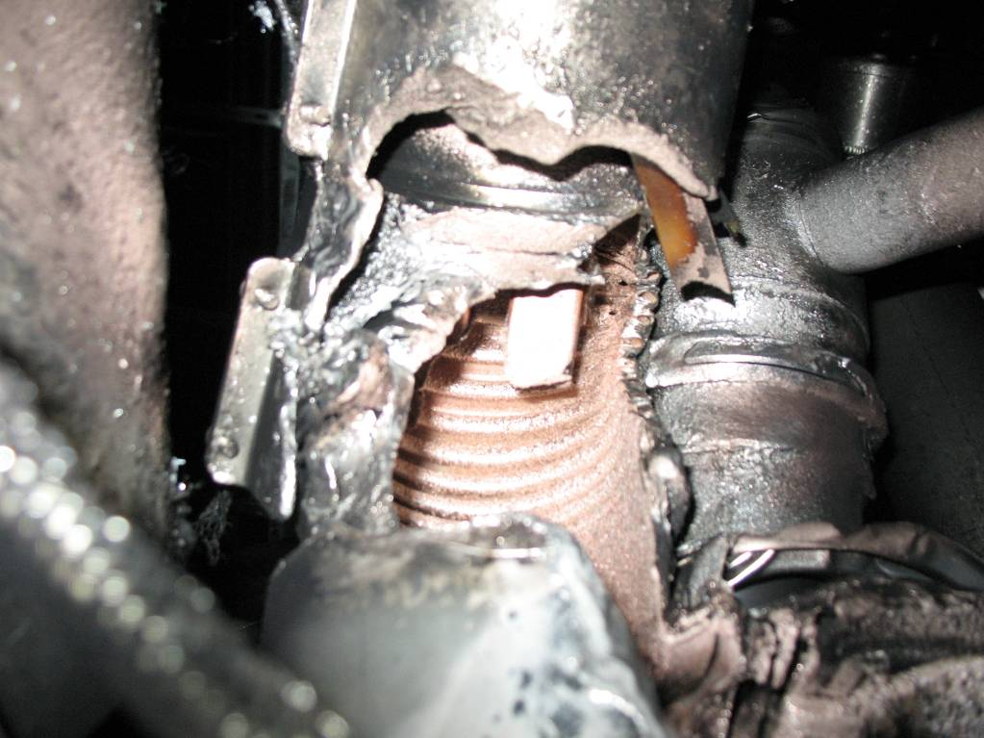
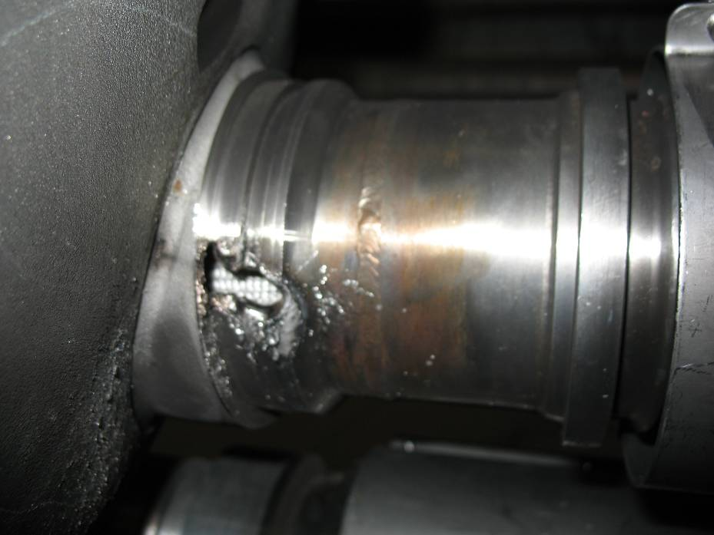
Collateral Damage: Secondary Arcs
QBBI.B31R3 M3 line
QQBI.27R3 M3 line

Slide 36
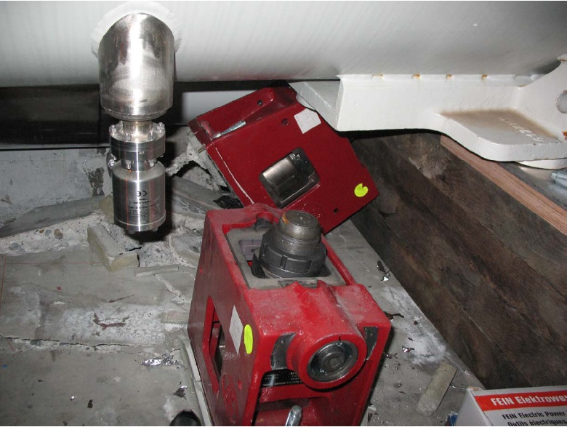
Collateral Damage: Ground Supports

Slide 37
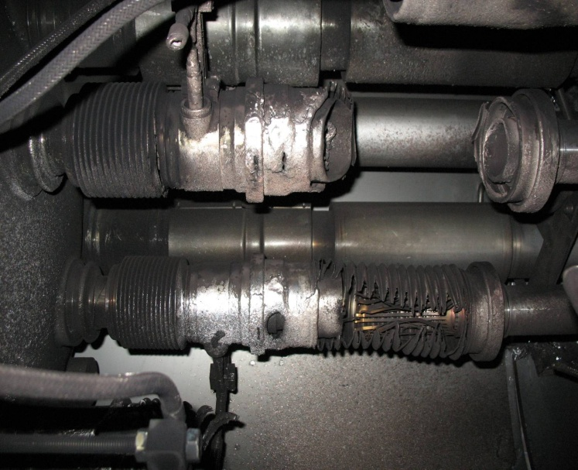
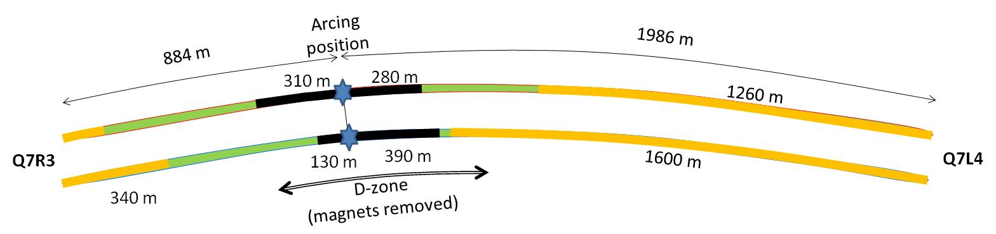

Collateral Damage: Beam Vacuum
Arc burned through beam vacuum pipe
clean
MLI
soot
The beam pipes were polluted with thousands of pieces of MLI and soot, from one extremity to the other of the sector
LSS3
LSS4
OK
Debris
MLI
Soot

Slide 38
Important Questions About “The Incident”
Why did the joint fail?
Inherent problems with joint design
No clamps
Details of joint design
Solder used
Quality control problems
Why wasn’t it detected in time?
There was indirect (calorimetric) evidence of an ohmic heat loss, but these data were not routinely monitored
The bus quench protection circuit had a threshold of 1V, a factor of >1000 too high to detect the quench in time.
Why did it do so much damage?
The pressure relief system was designed around an MCI Helium release of 2 kg/s, a factor of ten below what occurred.

Slide 39
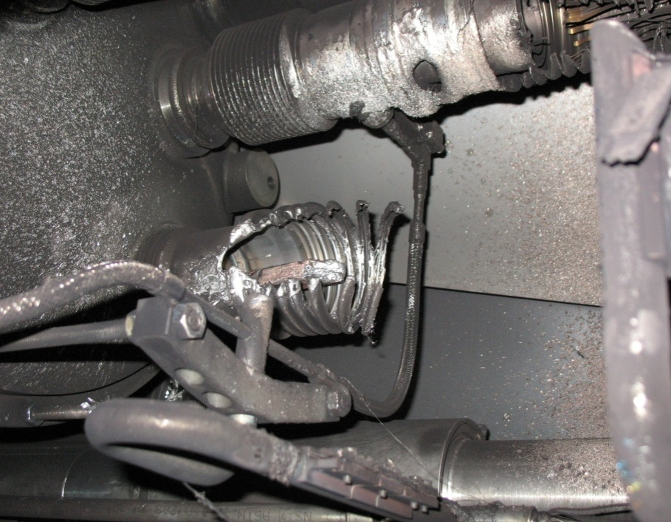
What happened?
Working theory: A resistive joint of about 220 nΩ with bad electrical and thermal contacts with the stabilizer
No electrical contact between wedge and U-profile with the bus on at least 1 side of the joint
No bonding at joint with the U-profile and the wedge
Loss of clamping pressure on the joint, and between joint and stabilizer
Degradation of transverse contact between superconducting cable and stabilizer
Interruption of longitudinal electrical continuity in stabilizer
Problem: this is where the evidence used to be
A. Verweij

Slide 40
Improvements
Bad joints
Test for high resistance and look for signatures of heat loss in joints
Warm up to repair any with signs of problems (additional three sectors)
Quench protection
Old system sensitive to 1V
New system sensitive to .3 mV (factor >3000)
Pressure relief
Warm sectors (4 out of 8)
Install 200mm relief flanges
Enough capacity to handle even the maximum credible incident (MCI)
Cold sectors
Reconfigure service flanges as relief flanges
Reinforce floor mounts
Enough capacity to handle the incident that occurred, but not quite the MCI

Slide 41
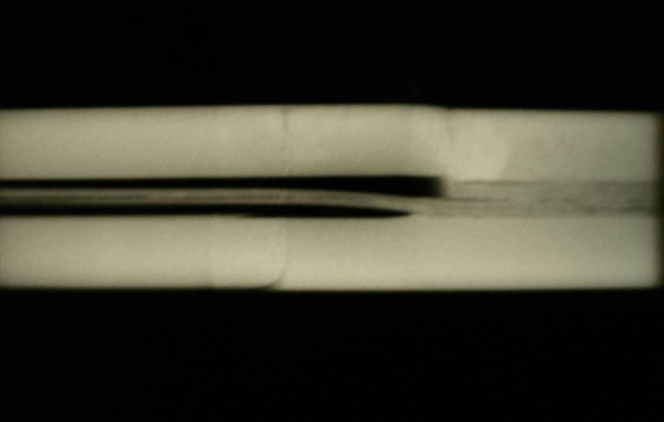
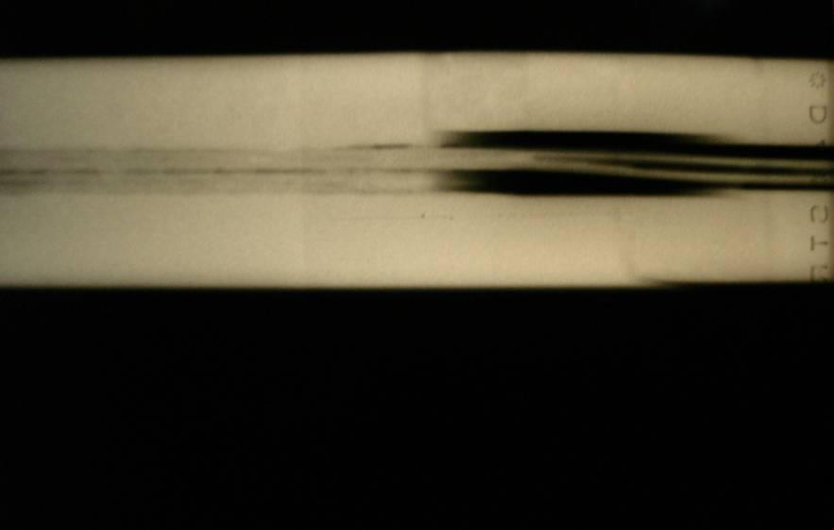
Bad Surprise
With new quench protection, it was determined that joints would only fail if they had bad thermal and bad electrical contact, and how likely is that?
Very, unfortunately ⇒ must verify copper joint
Have to warm up to at least 80K to measure Copper integrity.
Solder used to solder joint had the same melting temperature as solder used to pot cable in stablizer
⇒Solder wicked away from cable

Slide 42
Impact of Joint Problem
Tests at 80K identified an additional bad joint
One additional sector was warmed up
New release flanges were NOT installed
Based on thermal modeling of the joints, it was determined that they might NOT be reliable even at 5 TeV
3.5 TeV considered the maximum safe operating energy for now
Will run at that energy until a major (~15 month) shutdown to fully repair all 10,000 (!!) joints
Re-solder
Clamp
Inspect

Slide 43
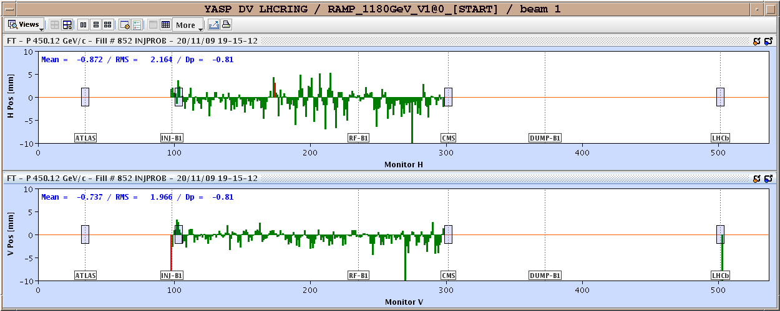
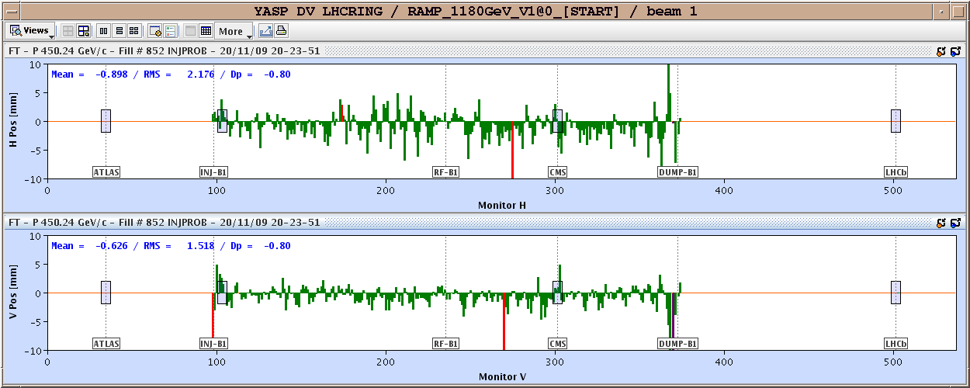
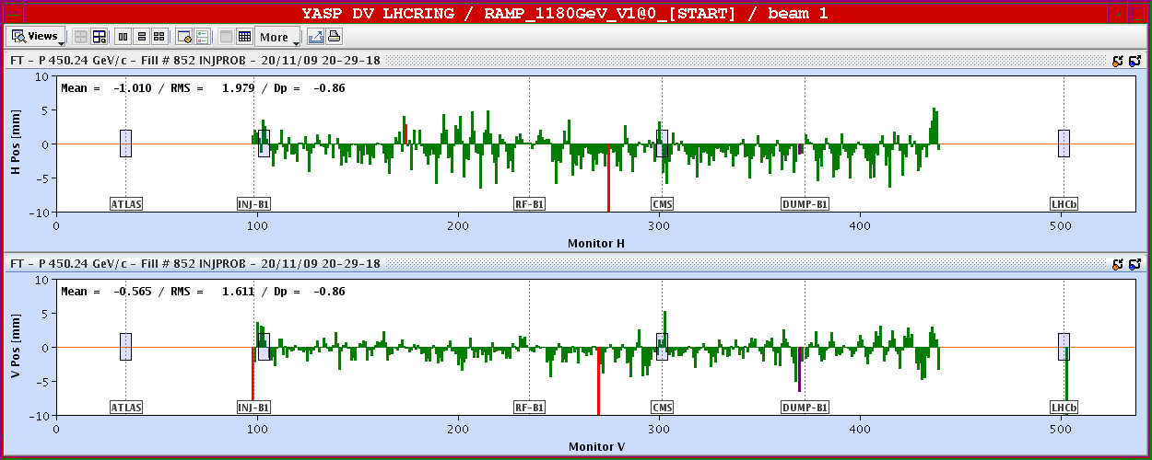
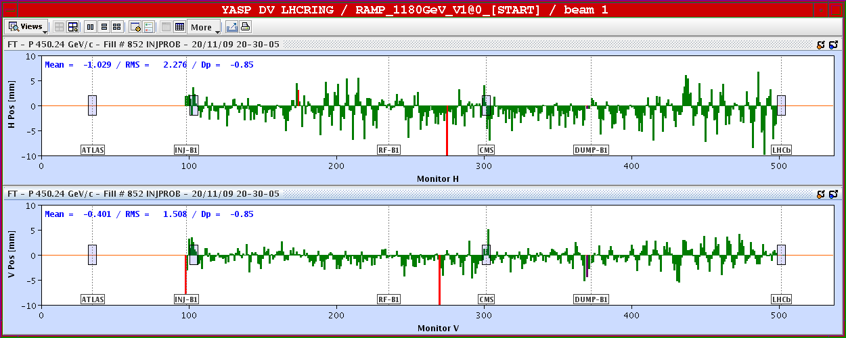
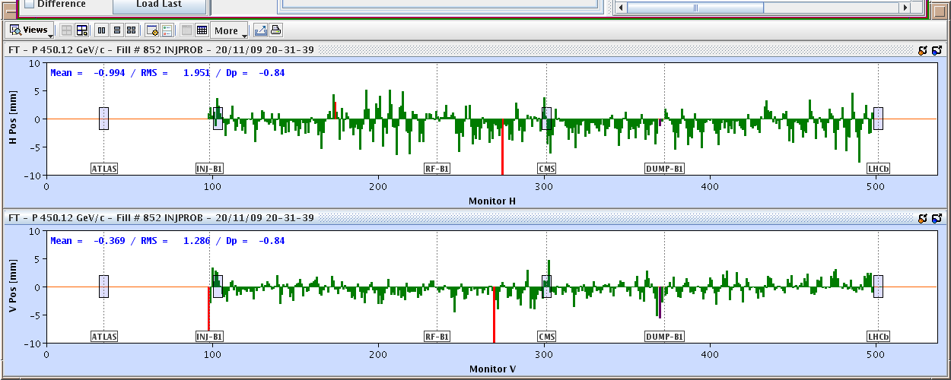
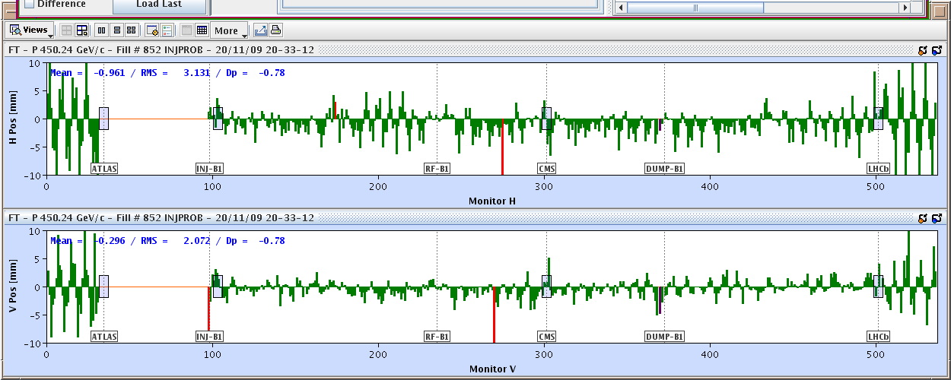
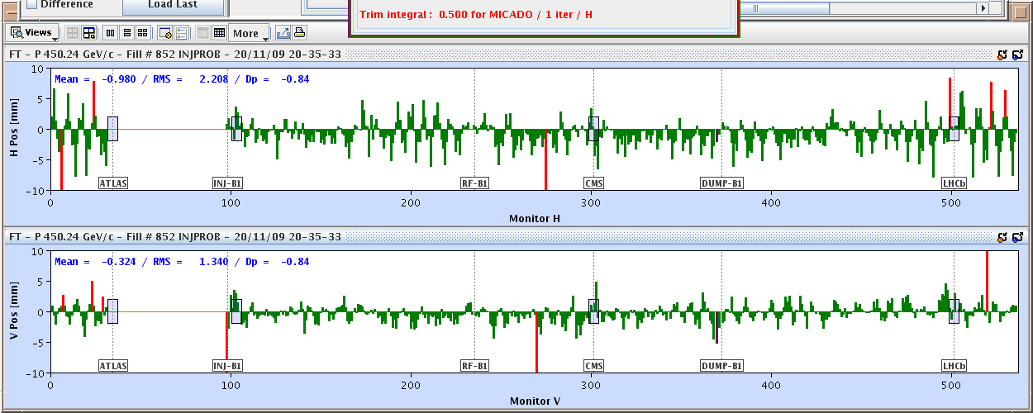
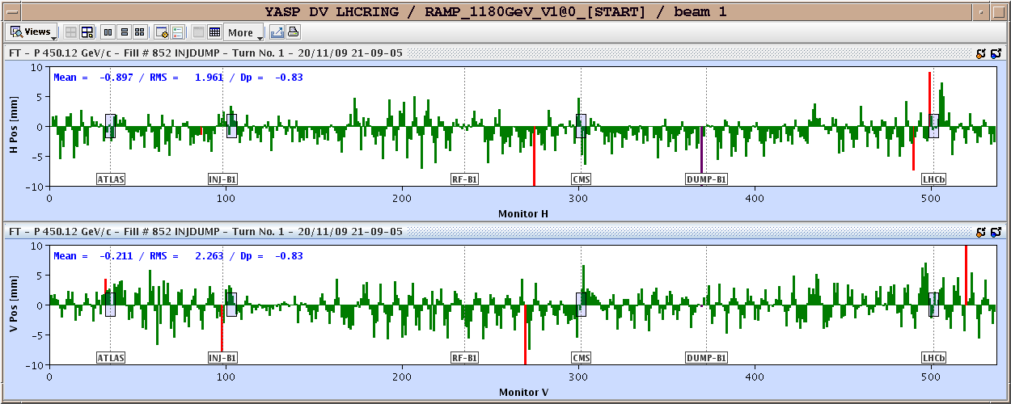
November 20, 2009: Going Around…Again
Total time: 1:43
Then things began to move with dizzying speed…

Slide 44
Progress After Start Up
Sunday, November 29th, 2009:
Both beams accelerated to 1.18 TeV simultaneously
LHC Highest Energy Accelerator
Monday, December 14th
Stable 2x2 at 1.18 TeV
Collisions in all four experiments
LHC Highest Energy Collider
Tuesday, March 30th, 2010
Collisions at 3.5+3.5 TeV
LHC Reaches target energy for 2010/2011
Then the hard part started…

Slide 45
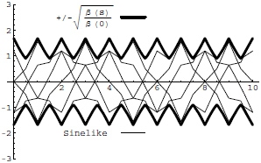
Digression: All the Beam Physics U Need 2 Know
Transverse beam size is given by
Betatron function: envelope determined by optics of machine
Trajectories over multiple turns
Note: emittance shrinks with increasing beam energy ⇒”normalized emittance”
Emittance: area of the ensemble of particle in phase space
Area = ε
Usual relativistic β & γ

Slide 46
Collider Luminosity
For identical, Gaussian colliding beams, luminosity is given by
Revolution frequency
Number of bunches
Bunch size
Betatron function at collision point
Transverse beam size
Normalized beam emittance
Geometric factor, related to crossing angle.

Slide 47
Important Features of the Focal Region
β
β distortion of off-momentum particles ∝ 1/β* (affects collimation)
s
⇒ small β* means large β (aperture) at focusing triplet

Slide 48
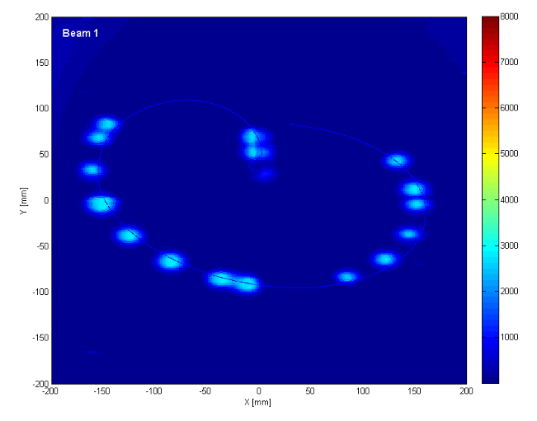
General Plan
Push bunch intensity
Already reached nominal bunch intensity of 1.1x10¹¹ much faster than anticipated.
Remember: L∝N_{b}²
Rules out many potential accelerator problems
Increase number of bunches
Go from single bunches to “bunch trains”, with gradually reduced spacing.
At all points, must carefully verify
Beam collimation
Beam protection
Beam abort
Remember:
TeV=1 week for cold repair
LHC=3 months for cold repair
Example: beam sweeping over abort

Slide 49
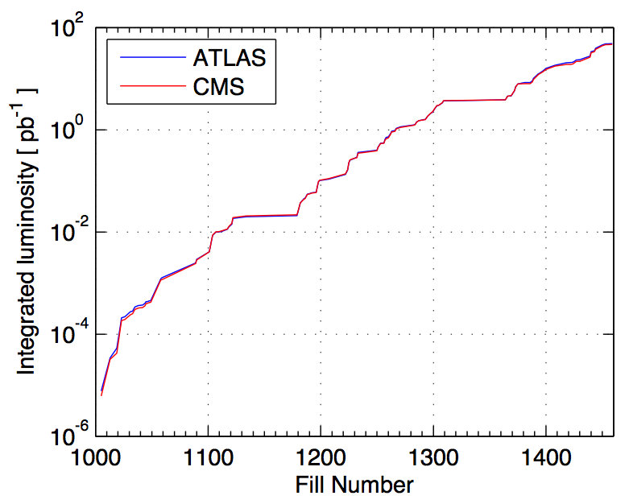
2010 Performance*
Performance ramp-up (368 bunches)
Nominal bunch operation (up to 48)
Bunch trains
Initial luminosity run
Nominal bunch commissioning
*From presentation by DG to CERN staff

Slide 50
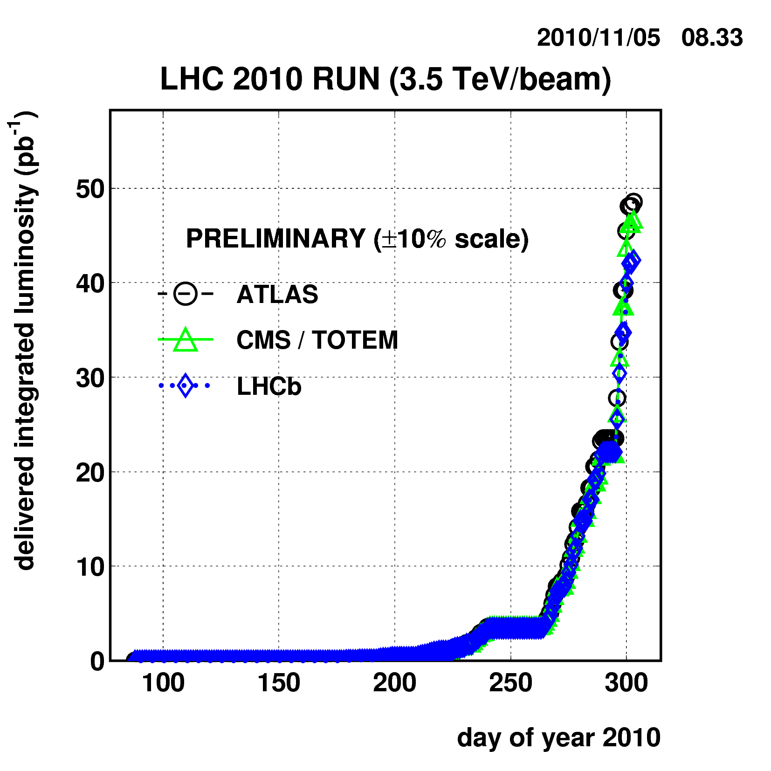
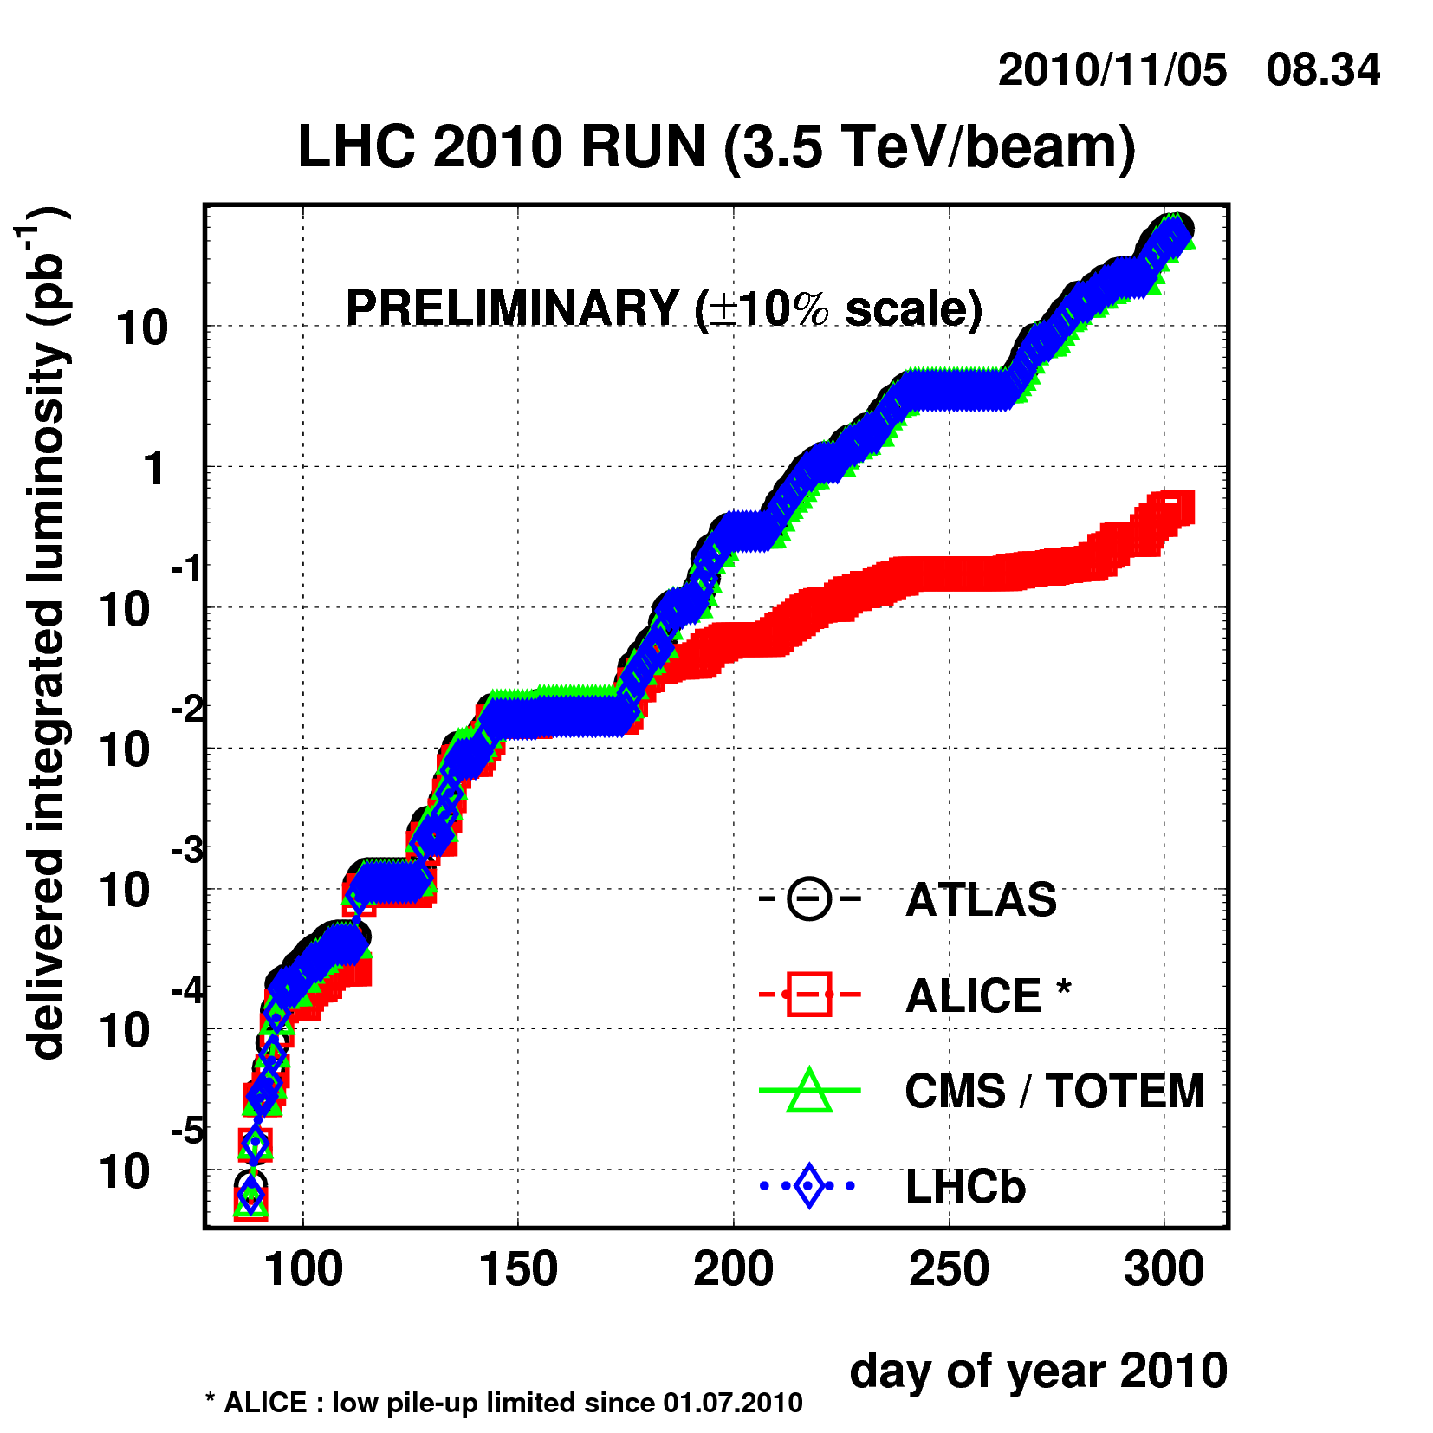
Current Status
Reached full bunch intensity
1.1x10¹¹/bunch
Can’t overstate how important this milestone is.
Peak luminosity: ~2x10³² cm⁻²s⁻¹
Enough to reach the 1 fb⁻¹ goal in 2011

Slide 51
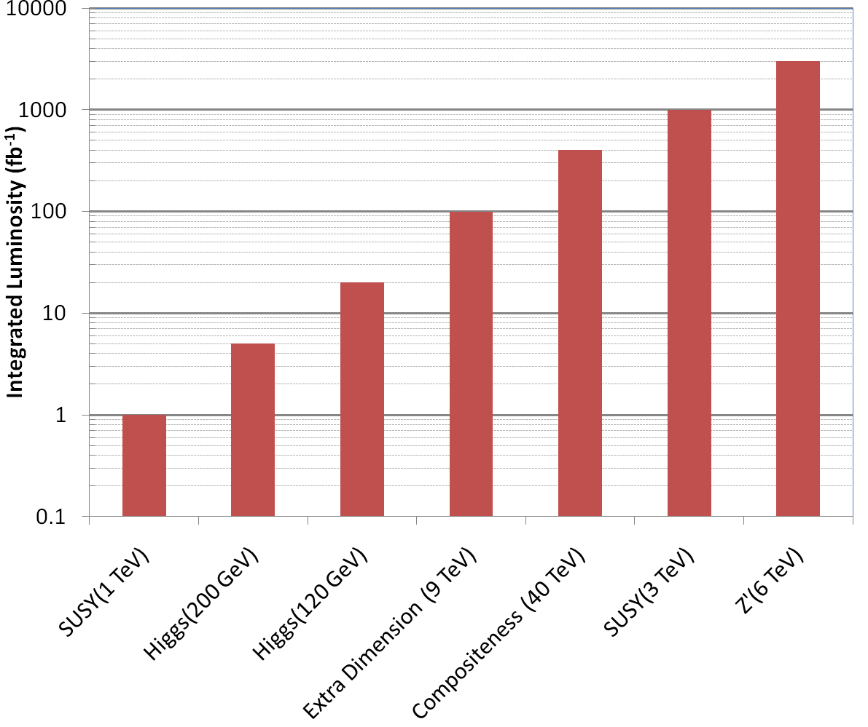
Nice Work, but…
3000 fb⁻¹
~2500 years at present luminosity
~50 years at design luminosity
The future begins now

Slide 52
Limits to LHC Luminosity*
Rearranging terms a bit…
Total beam current. Limited by:
Uncontrolled beam loss!
E-cloud and other instabilities
Brightness, limited by
Injector chain
Max. beam-beam
If n_{b}>156, must turn on crossing angle…
β at IP, limited by
magnet technology
chromatic effects
…which reduces this
*see, eg, F. Zimmermann, “CERN Upgrade Plans”, EPS-HEP 09, Krakow

Slide 53
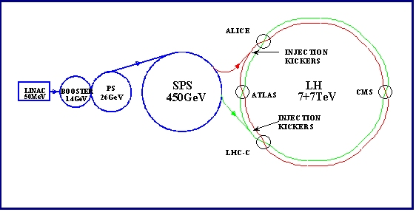
Current LHC Injector Chain
Particularly important
Electron cloud and other instabilities
Space Charge Limitations at Booster and PS injection
Transition crossing in PS and SPS
Schematic ONLY. Scale and orientation not correct

Slide 54
Attacking Luminosity on Many Fronts
Total beam current:
Probably limited by electron cloud in SPS
Beam pipe coating?
Feedback system?
Beam size at interaction region
Limited by magnet technology in final focusing quads
Nb₃Sn?
Chromatic effects⇔collimation
Still being investigated
Beam brightness (N_{b}/ε)
Limited by injector chain
New LINAC
Increased Booster Energy
PS⇒PS2
Biggest uncertainty is how to deal with crossing angle…
unlikely

Slide 55
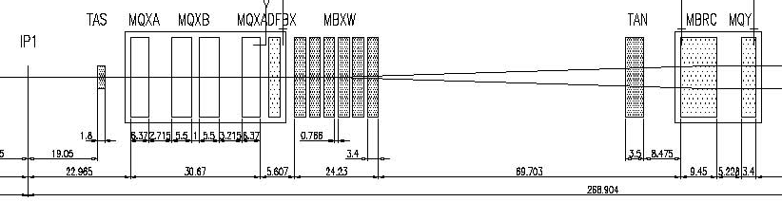
IR Layout and Crossing Angle
Present Separation Dipole
Final Triplet
IP
~59 m
Nominal Bunch spacing: 25 ns ⇒7.5 m
Collision spacing: 3.75 m
~2x15 parasitic collisions per IR
To eliminate crossing angle would require separation dipole ~3 m from IP, ie within detector!
“Early Separation” scheme; possible, not likely
Implement Crossing Angle for n_{b}>156

Slide 56
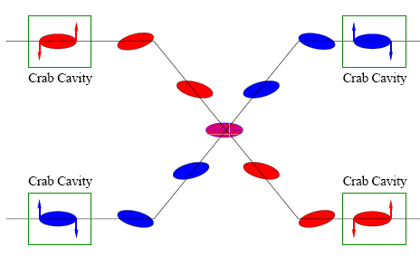
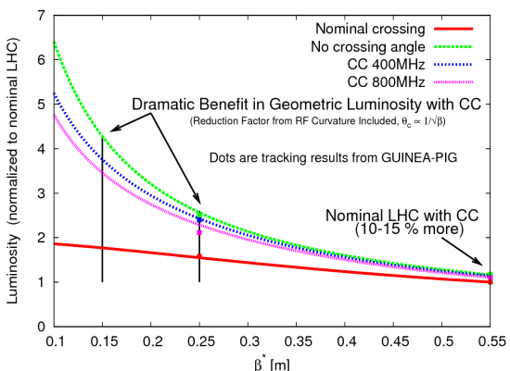
Base Line Option: Crab Cavities
Lateral deflecting cavities allow bunches to hit head on even though beams cross
Successfully used a KEK
Additional advantage:
The crab angle is an easy knob to level the luminosity, stretching out the store and preventing excessive pile up at the beginning.

Slide 57

The Case for New Quadupoles
HL-LHC Proposal: β*=55 cm ⇒ β*=10 cm
Just like classical optics
Small, intense focus ⇒ big, powerful lens
Small β*⇒huge β at focusing quad
Need bigger quads to go to smaller β*
Existing quads
70 mm aperture
200 T/m gradient
Proposed for upgrade
At least 120 mm aperture
200 T/m gradient
Field 70% higher at pole face
⇒ Beyond the limit of NbTi

Slide 58

Motivation for Nb₃Sn
Nb₃Sn can be used to increase aperture/gradient and/or increase heat load margin, relative to NbTi
Limit of NbTi magnets
Very attractive, but no one has ever built accelerator quality magnets out of Nb₃Sn
Whereas NbTi remains pliable in its superconducting state, Nb3Sn must be reacted at high temperature, causing it to become brittle
Must wind coil on a mandrel
React
Carefully transfer to magnet
120 mm aperture

Slide 59

LARP Magnet Development Tree
Completed
Achieved
220 T/m
Length scale-up
High field
Accelerator features
Being tested

Slide 60
Plan for Next Decade
Run until end of 2012 of integrated luminosity
Between 2 and 10 fb⁻¹ of integrated luminosity
Shut down for ~15 month to fully repair all ~10000 faulty joints
Resolder
Install clamps
Install pressure relief on all cryostats
Shut down in ~2017
Tie in new LINAC
Increase Booster energy 1.4->2.0 GeV
Finalize collimation system (LHC collimation is a talk in itself)
Shut down in ~2021
Full luminosity: >5x10³⁴ leveled
New inner triplets based on Nb₃Sn
Crab cavities
Large Pewinski Angle being pursued as backup

Slide 61

The Long Road to Discovery
Even with the higher luminosity, still need a lot of time to reach the discovery potential of the LHC
Lots of new challenges between now and then!
Z’@6TeV
ADD X-dim@9TeV
SUSY@3TeV
Note: VERY outdated plot. Ignore horizontal scale.
Could conceivably get to 3000 fb⁻¹ by 2030.
3000
Compositeness@40TeV
H(120GeV)→γγ
300
Higgs@200GeV
SUSY@1TeV
30
200 fb⁻¹/yr
HL-LHC Upgrade
10-20
fb⁻¹/yr
50-100 fb⁻¹/yr
500 fb⁻¹/yr
50 x Tevatron luminosity
250 x Tevatron luminosity

Slide 62
Acknowledgements
Janet Conrad, for inviting me
The authors of all of the talks I’ve plagiarized, particularly those presented the annual “LHC Performance Workshops”, held in Chamonix, France
http://tinyurl.com/Chamonix2009
http://tinyurl.com/Chamonix2010
http://tinyurl.com/Chamonix2011
PowerPoint, for letting me recycle stuff from my old talks
Google, without which nothing would be possible
You, for listening

Slide 63
BACKUP SLIDES

Slide 64
CERN: A brief history
1951 – In a move to rebuild European science after WWII, the “Conseil Européen pour la Recherche Nucléaire” (CERN) established in a UNSESCO resolution proposed by I.I. Rabi to “establish a regional laboratory”
1952 – Geneva chosen as the site
1954 – “European Organization for Nuclear Research” officially formed of 12 member states – retains acronym “CERN”
1957 – first accelerator operation (600 MeV synchro-cyclotron)
1959 – 28 GeV proton synchrotron (PS) cements the tradition of extremely unimaginative acronyms
PS (and acronym policy) still in use today!
1971 – Intersecting Storage Rings (ISR) – first proton-proton collider
1983 – SppS becomes first proton-antiproton collider
Discovers W+Z particles: 1984 Nobel Prize for Rubbia and van der Meer
1989 – 27 km Large Electron Positron (LEP) collider begins operation at CM energy of 90 GeV (Z mass)
Unprecedented tests of Standard Model
1990 – Tim Berners-Lee invents the WWW
2000 – Dan Brown writes a very silly book

Slide 65


After initial circulation: captured beam
Turn Number
Time
Everything was going great until something very bad happened on September 19th
Initially, CERN kept a tight lid on news

Slide 66


Optics at 1.18 TeV
β functions
Dispersion

Slide 67


Beam Control at 1.18 TeV
Position control
Tune feedback
Bump introduced
Removed by feedback loop
Feel happy that yellow line and pink line add up to blue line
Automated feedbacks seem to be working, but not quite yet standard operations.
Bottom line: things look good!

Slide 68

Limits of Phase I Collimation System*
Collimation at tightest settings throughout ramp and squeeze
Somewhat more relaxed collimation settings
*Ralph Assmann, “Cassandra Talk”

Slide 69

Collimation Limits to Luminosity

Slide 70



Optics Studies (examples)

Slide 71


Slide 72

Nothing’s perfect
Recall : ideal quadrupole:
Beam (out of page)
Horizontal Plane:
Vertical Plane:
But what if it’s offset?
Focus
Bend
=
+
Big error? Move quad
Small error? Correct for problem

Slide 73
Betatron motion
For a particular particle, the deviation from an idea orbit will undergo “pseudo-harmonic” oscillation as a function of the path along the orbit:
x
Lateral deviation in one plane
s
The “betatron function” β(s) is effectively the local wavenumber and also defines the beam envelope.
Phase advance
A transverse “kick” (θ) (misaligned quad, miscalibrated dipole, etc) at one location in a beam will produce a lateral deviation at later points given by
Linear relationship
In general, these can be canceled with a discrete set of intentional corrections

Slide 74
Orbit correction
Generally, beam lines or synchrotrons will have beam position monitors (BPM’s) and correction dipoles (trims)
We would like to use the trims to cancel out the effect of beamline imperfectins, ie
Can express this as a matrix and invert to solve with standard techniques
If n=m, can just invert
If n>m, can minimize RMS
Cancel displacement at BPM i due to imperfections
Setting of trim j

Slide 75
Nominal plan for 2010/2011
1-2% of nominal luminosity
~100 pb⁻¹/month
already exceeded this

Slide 76

Tentative LHC Timeline
Energy: 3.5 TeV
Energy: 6-7 TeV
Collimation limit ~2-5x10³²
Collimation limit .5-1x10³⁴
Energy: ~7.0 TeV
Energy: ~7 TeV
Luminosity→1x10³⁴
Lum.→>5x10³⁴
Collimation limit >5x10³⁴

